Slide 1



C GAMES WIDE OPEN GAMES WIDE OPEN GAMES WIDE OPEN
PARIS 2024 UNVEILS
ITS OFFICIAL LOOK
PRESS KIT - FEBRUARY 8 2023

Slide 2




EDITORIAL
I
f “Paris is a party”, with Paris 2024, this famous quote will take on an even stronger
meaning. A hundred years later, the return of the Summer Games to France will be an opportunity to bring exceptional moments of sport and joy to athletes and people
from all over the world.
The look of the Paris 2024 Games serves this objective: it aims to invite people to party, to magnify the athletes, to sublimate the beauty of the gesture, to engrave in our memory exceptional technical performances and visually superb moments .
The look is the identity of the Games, the forms and colors that adorn competition venues, cities and celebration areas for weeks. The look is what is seen on television by billions
of viewers, what is perceived by the millions of spectators in the stands and celebration areas, what the media reports .
The look is what should most simply and intuitively embody the spirit of an edition.
At Paris 2024, we will have a look that invites you to party, thanks to a colorful design
that will retain a French, elegant and aesthetic spirit, while keeping its resolutely sporty identity. The originality of our look will also be its customizable dimension, so that each territory can appropriate it and truly feel the spirit of the Games.
At Paris 2024, we want to offer the most beautiful setting possible to sport, to bring the look to life as widely as possible, so that the Games are available to as many people as possible.
With this look too, we will make the “Games Wide Open” happen .
Tony Estanguet Paris 2024 President
—厂
Paris 2024 will be all about highlighting the disciplines, athletes, host communities, celebration areas, in order to offer the conditions for a unique experience .
GAMES
WIDE OPEN
3

Slide 3

THE “LOOK” IS THE VISUAL IDENTITY
OF THE GAMES.
AN OFFICIAL IDENTITY FOR EVERY EDITION
CHAP.01
It is the decoration that will be used to dress every competition venue, together with the towns and celebration sites that will bedecked out in the Games colours for several weeks. The Look of the Games will also ensure the spirit of the celebrations reaches all around the world.
Every four years, the Olympic and Paralym- pic Games feature a new Look reflecting the culture of the host country and the spirit that the latest edition of the Games wants to embody.
AN OFFICIAL
IDENTITY
FOR EVERY
EDITION
© 2012 - Comité International O lympique (C IO) - HALLERAN, Scott
5

Slide 4

WRITING A PAGE IN HISTORY, WITH AFRENCH TOUCH
CHAP.02
PARIS 2024:
MEANING AND
ELEGANCE
3B
A look displayed
to 3 billion viewers
26K
media representatives
15K
athletes
45K
volunteers
PARIS 2024: MEANING AND ELEGANCE
At the core of the Paris 2024 visual concept is a great ambition: an invitation to
celebrate, a chance to grow sport and a showcase for what makes Paris, France and the Games so remarkable. The Paris 2024 visual identity is intentionally colourful and aesthetically pleasing, bold and refined, modern and full of symbolism, mirroring French elegance and the soul of this
edition of the Games.
Over the summer of 2024, this identity will accompany the finest sporting performances and will provide the backdrop to great
moments of shared emotion. It will also be deeply rooted in the collective memory of over three billion broadcast viewers, creating a place in history as it does so.
7

Slide 5

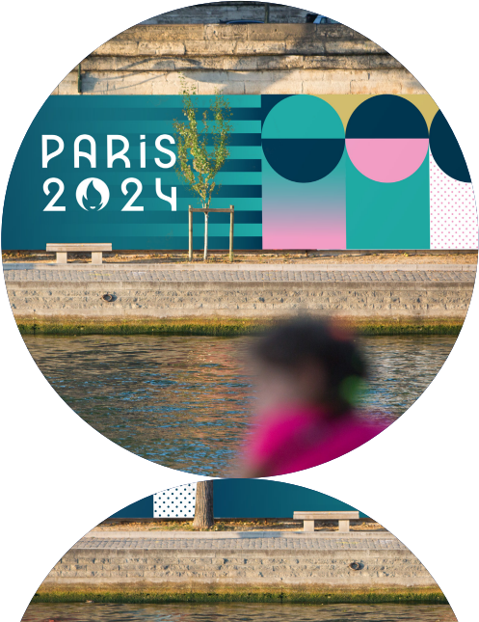
©Jean-Baptiste
Gurliat/Ville de Paris
GAMES
WIDE
OPEN
GAMES
WIDE
OPEN
GAMES WIDE OPEN GAMES
OPEN GAMES WIDE OPEN
© vm/Getty images

Slide 6
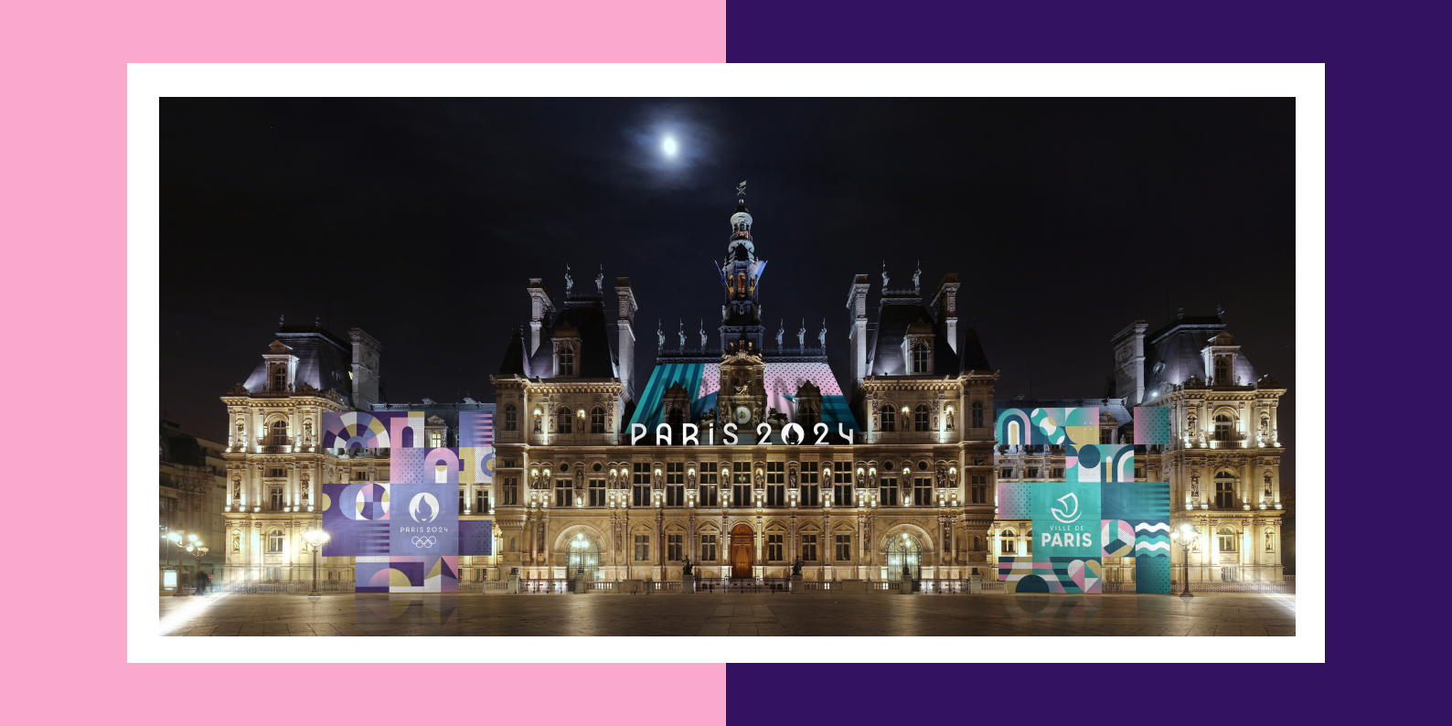
PARIS 2024: MEANING AND ELEGANCE
PARIS 2024: MEANING AND ELEGANCE
GAMES
WIDE OPEN
© Benh Lieu Song/CC BY-SA 3.0
10 11

Slide 7

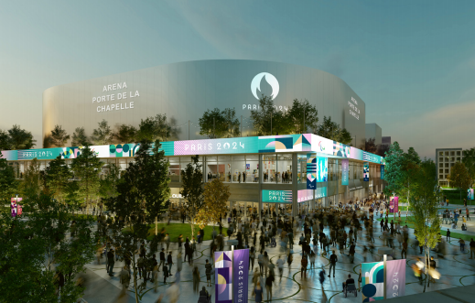
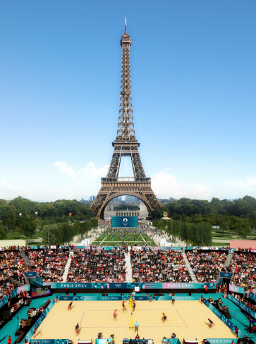
GAMES WITH A MEANING
PARIS 2024: MEANING AND ELEGANCE
PARIS 2024: MEANING AND ELEGANCE
The visual identity for the Olympic and Paralympic Games Paris 2024 has been conceived on the basis of four main
themes: celebration, transfer,
rationalisation, and personalisation.
CELEBRATION:
A SENSE OF FESTIVITY
An inviting look specially designed to bring together the sporting
community….and celebrate it.
For Paris 2024, the festive spirit of the greatest sporting event in the world is more than ever at the very heart of our project.
This is why the visual identity of the
Olympic and Paralympic Games Paris 2024 is intentionally colourful and joyful.
This look translates the exceptional
feelings that this worldwide celebration, so eagerly anticipated from all four
corners of the planet, will evoke.
© Paris 2024 /Mairie de Pa r is – SCAU / NP2F
TRANSFER:
A SENSE OF STYLE
Transferring sport into the city
with style.
The look of Paris 2024 does not com- promise on elegance, in keeping with Paris,the capital of fashion and the City of Light.
The Look has transferred inspiration
from the creative French spirit as well
as the Art Deco movement so in vogue in 1924, the year in which Paris last hosted the Games. Competition venues will
be sport personified, offering a more sober image in order to showcase
the athletes and their performances above all.
© Pa r is 2024
12
13

Slide 8

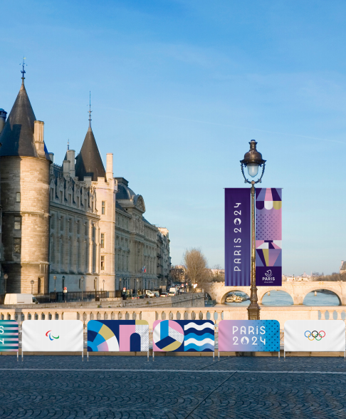
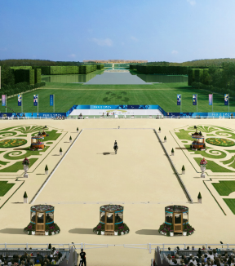


RATIONALISATION:
A SENSE OF RESPONSIBILITY
A single Look for the Olympic and Paralym- pic Games.
Paris 2024 has committed to making the
Games a more responsible event. This is why we have opted for a joint theme for
both the Olympic and the Paralympic
Games, with minimal changes between the two. The look will remain the same, with just the Olympic rings being replaced by the Agitos,while certain Olympic pictograms are replaced by the Paralympic ones.
This decision has been taken to prioritise responsibility, rationalise costs and
reduce the environmental impact
of the event.
PARIS 2024: MEANING AND ELEGANCE
OPEN GAMES WIDE OPEN
GAMES WIDE OPEN GAMES
© Pa r is 2024
PERSONALISATION: A
SENSE OF THE COLLECTIVE
Paris 2024 is a Games by everyone and for everyone.
It will bring together every region of the
country, in mainland France and beyond. For the first time, the look of the event
will therefore be customised with the co- lours and style of the host communities and partners who, along with Paris 2024, have each had the opportunity to perso- nalise the Look in their image: a genuine first in the history of the Games.
© Mel Stua rt/Getty Images
15

Slide 9




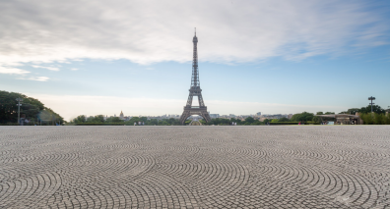
REFERENCING ALL LOCAL
REGIONS
GAMES THAT WILL PAVE THE WAY
The Look of the Games is rich with sym- bolic meaning. Following the Marianne
as an emblem and the Phrygian cap for the mascots, both strong representations of the Republic, the paving stone has
been given pride of place. This integral part of the French urban and historic
landscape has been used since Antiquity and was subsequently developed in Paris from the Middle Ages, becoming more
widespread in the 19th century due to the emergence of traffic systems.
CHAP.03
GAMES THAT WILL PAVE THE WAY!
© Iupengyu/Getty Images
17

Slide 10


Slide 11
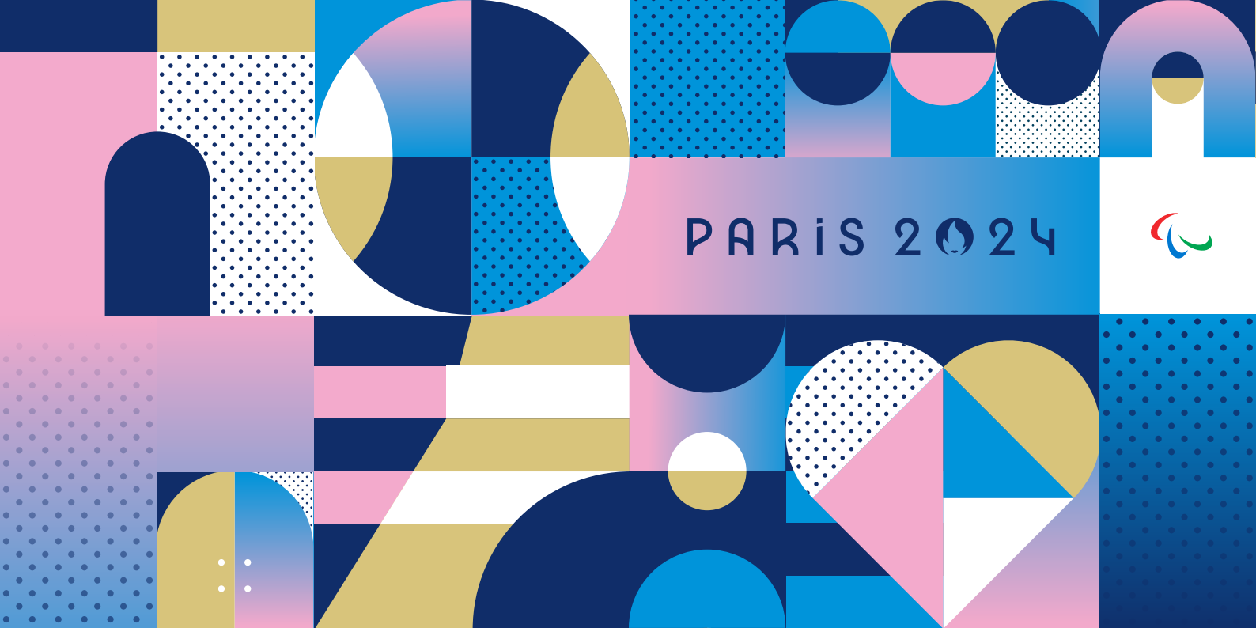

Slide 12
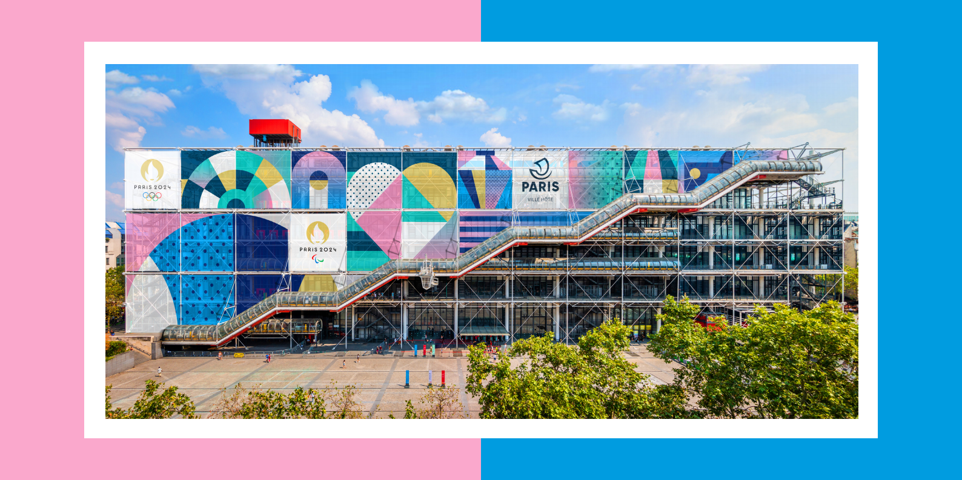
GAMES THAT WILL PAVE THE WAY
GAMES THAT WILL PAVE THE WAY
GAMES
WIDE OPEN
© Pompidou, acteur essentiel de l ’O lympiade cu ltu re l le - Charles Leona rd/Shutte rstock.com
CENTRE POMPIDOU
MAJOR STAKEHOLDER
IN THE CULTURAL OLYMPIAD
22 23

Slide 13

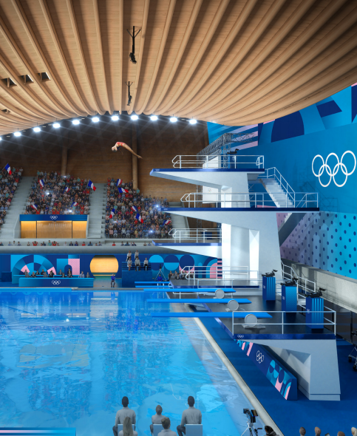
These squares, juxtaposed paving stones were used as the unit of measurement for the creative grid designed for the Games. They can be assembled and adjusted
in any way to depict French material and immaterial heritage and have been
adorned with three different types of symbols: the images of sport,
emblematic places, or a celebration of our French way of life.
The blue, red, green, and violet pastel
paving stones take on a new form when
tinted, combining elegance and a lightness of spirit. These colours symbolise
the richness and diversity of France.
GAMES THAT WILL PAVE THE WAY
GAMES THAT WILL PAVE THE WAY
GAMES
WIDE OPEN
© Paris 2024 / A 2/3/4 et Venhoeven CS
24
25

Slide 14


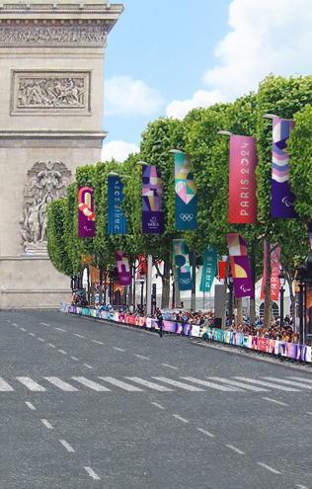
From the outset of the Paris 2024 adventure,
we have shown the same ambition: to
mark history by offering a new,
unprecedented type of Games in order to conjure unforgettable emotions and offer a truly one-off experience to the greatest number of people possible. As our motto says, we have “Games Wide Open”!
This desire to break with tradition and
reinvent the great Olympic and Paralympic reference points drives our ambition in all
aspects of the Games: the Opening Cere-
monies, will beheld in the city centre for the first time, the “Mass Event Running” that will bring the experience of the Olympic mara- thon course to thousands of amateur run- ners in an unprecedented and amazing way.
CHAP.04
MARKING
HISTORY THROUGH
EXCEPTIONAL
ACHIEVEMENT
MARKING HISTORY THROUGH EXCEPTIONAL ACHIEVEMENT
© Pa r is 2024
The look of Paris 2024 carries this same innovative and bold
desire to surprise whilst also
honouring French codes of
elegance, and the historic
symbols and revolutionary spirit that are the pride of Paris
and all of France.
27

Slide 15













CLEAR SIGNS
OF OUR AMBITION
AN ICONIC EMBLEM
The Paris 2024 emblem is a clear sign of our unique approach
to the Games. It combines three symbolic components (the medal, the flame and a Marianne, representing the Republic) that comprise the face of the Paris 2024 Games. This face is that of a Games open to all and especially women, since Paris 2024 will be the first
edition in the history of the Olympic Games to achieve a perfect gender balance of athletes. This decision also refers to the women who, in 1900, were able to take part for the first time in the Olympic Games, in Paris. Another first is that the emblem is the same
for the Olympic and the Paralympic Games, for which Paris 2024 shares the same level of ambition and demand.
A “REVOLUTIONARY” MASCOT
Throughout history, many mascots have been animals that
encapsulates the host nation. The Paris 2024 mascots have broken from this tradition, embodying an ideal, a powerful symbol of
freedom and a historical reference that is known by all French people. The mascots, the Phryges, are two small Phrygian caps that drive the revolution for sport. An Olympic and Paralympic mascot, each with its own personality, designed to carry the French people and the whole world forwards to the Paris 2024 Games.
MARKING HISTORY THROUGH EXCEPTIONAL ACHIEVEMENT
MARKING HISTORY THROUGH EXCEPTIONAL ACHIEVEMENT
OPEN GAMES WIDE OPEN
GAMES WIDE OPEN GAMES
f
J
PAR S 2 2
P R S 2 2
ai
am
28
29

Slide 16


